Slide 1
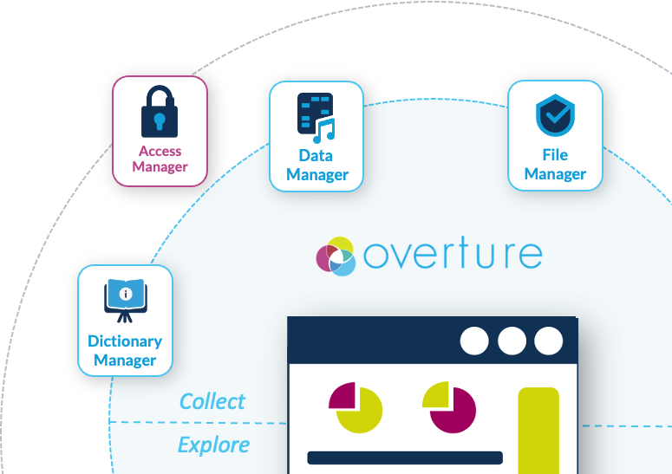


September 2026
Product Overview
Access Manager: Usher
Repository
GitHub.com/Overture-Stack/Usher
Lead
Justin Richardsson
Presented By
Notes:
Acceptance criteria at the end what functionality and use cases
Match between user reqs and checkboxes at the end
Bringing our data platforms into a conversational interface for data discovery and biological interpretation, and beyond.
I'll start with what Overture is and how we got here, then the opportunity we saw in connecting our search API to large language models through MCP, and how it works for a real user, and finish with where we're taking it next.

Slide 2



Product Overview
Fundamental Problem
When access conditions can vary record by record, how do we ensure each person sees only the data they're authorized to see.
“To be OCAP compliant we need to be able to restrict the subset of Indigenous data in a platform to only users authorized to view that data”
“To support conversational discovery over controlled ARGO data, the Arranger Search API must enforce per-user, record-level authorization on every query issued through the MCP server.”
“Legal privacy requirements for PI/PHI data mandate least-privilege access, restricting both the number of users and the scope of data each can access, requiring granular authorization rules”
Notes:
We're the Genome Informatics group. We specialize in building software that enables researchers to connect and collaborate over shared data, and we have a lot of experience doing this.
We host a large portfolio of projects, and one reason we're able to do that is because for every project we commit a small amount of our development effort to reusable components, which we then reuse in future projects to be more efficient and build more robust platforms.
The culmination of that reusable development effort has led us to…

Slide 3
Product Overview
Fundamental Problem
This presentation covers only the policy definitions and their enforcement.
Notes:
We're the Genome Informatics group. We specialize in building software that enables researchers to connect and collaborate over shared data, and we have a lot of experience doing this.
We host a large portfolio of projects, and one reason we're able to do that is because for every project we commit a small amount of our development effort to reusable components, which we then reuse in future projects to be more efficient and build more robust platforms.
The culmination of that reusable development effort has led us to…

Slide 4


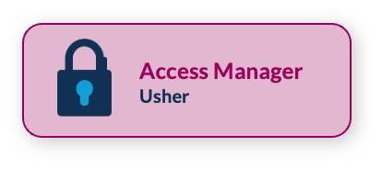
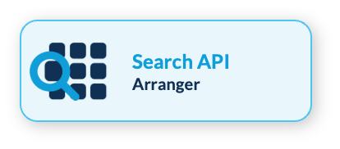
Product Overview
Core Questions
Permission/Admin UI?
Who are you?
Can we flexibly (as permissive as possible) and sustainably (admins can manage it) control access on filtered Arranger search responses?
What access conditions are attach to this record?
Who is asking, and what have they been granted?
Are those grants still valid right now?
Would every application in the platform answer the same way?
Can this decision be reconstructed later?
What happens when the answer cannot be determined?
What can you see or do?
Notes:
Update Access Manager card to Usher underneath

Slide 5
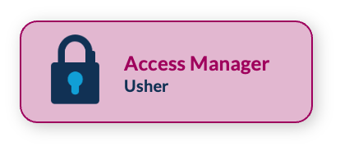
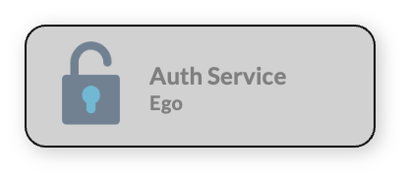
Product Overview
Division of Responsibility
Usher: What can you see or do? Access grants are documented once and enforced across Overture services.
Policy model does not exist in overture we need this.
Keycloak: Who are you? Accounts, groups, sign-in.
Ego: Did both jobs (too much) in one service.
Jon: Not necessary too much for one service, we are not experts at authentication we do not want to sink valued development effort in capabilities for which we don’t need to.
Justin also offloading this leverages the interoperability of a widely adopted service
Notes:
Why redevelop keycloaks existing authorization service?
Keycloak has a plugin to do authz but does not offer the level of flexibility that we will need for granular controls, they implement roles and attributes but not Role + Attribute based access control
Why don’t we build on top of the keycloak authorization
That’s what we are doing but implementing it as a layer on top of keycloak rather than inside of keylcoak
Using PCGL as an example, if we are strictly tied to keycloak’s auth system we would not have a mechanism to integrate with something else. Part of this service is writing an adapter we want to make sure that service is portable
There is no third party tool or library that will provide this level or functionality (nothing we can build on and extend)
No, not out of the box, and not anything sustainably maintained, comparison of software tools.
Note design currently takes into account ga4gh passports

Slide 6
Product Overview
Three Broad Access Tiers
Open: No sign-in required, publicly available open access data.
The ushered application still asks Usher what an anonymous visitor may reach, and Usher still answers and records that it answered.
Registered: Login required to view all the data.
Users must log in and accept the platforms terms of use to view data.
Controlled: Access is only granted to those with the appropriate permissions
Typically, access is granted following a data access request and a committee review and approval. The researcher once logged in sees only the fields & records they’ve been approved to view.
Notes:
The easiest part of the model to hold in mind.
Open is anonymous, but the request still goes through Usher rather than around it, so open access is logged like everything else.
Registered is identity plus accepted terms.
Controlled is granted deliberately by the custodian or the dataset owner, dataset by dataset. In larger deployments an access committee reviews first.
The line that matters is the last one. Registered never becomes sufficient for controlled data on its own.

Slide 7
Product Overview
Anatomy of a permission
Permission
Permission
A user is allowed to use a capability on a resource's categorized data
"HEART_STUDY": {
"open": {"record": ["read"] }
"controlled": {"record": ["read"] }
}
Resource
A group of records defined by a common field and value, set by the admin
In plain language: the open & controlled records in HEART_STUDY may be read, in full.
Category
A label for identifiers inside a resource
Fields
Which parts of a record the grant covers.
Not in the MVP. Grants cover whole records.
Capability
What the system is able to do
Notes:
The easiest part of the model to hold in mind.
Open is anonymous, but the request still goes through Usher rather than around it, so open access is logged like everything else.
Registered is identity plus accepted terms.
Controlled is granted deliberately by the custodian or the dataset owner, dataset by dataset. In larger deployments an access committee reviews first.
The line that matters is the last one. Registered never becomes sufficient for controlled data on its own.

Slide 8
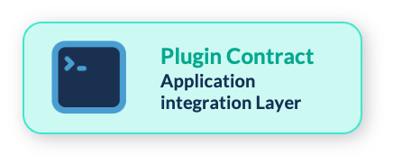
Product Overview
Anatomy of a permission
Grant Token
Permission
A user is allowed to use a capability on a resource's categorized data
"XX_HEART_DATA": {
"open": {"record": ["read"] }
"controlled": {"record": ["read"] }
"over-fifty": {"record": ["read"] }
}
Resource
A group of records defined by a common field and value, set by the admin
In plain language: the open & controlled records in HEART_STUDY may be read, in full.
Category
A label for identifiers inside a resource
Fields
Which parts of a record the grant covers.
Not in the MVP. Grants cover whole records.
The admins defines categories within their search API configs.
Capability
What the system is able to do
category: controlled
field: access_level
value: restricted
Notes:
How is record defined?
A record in a heart study is individuals
Name
Age
… Clinical data
Validation/Enforcement of the grants/permission against the arranger configurations against the data itself?
Balance of ease of use and flexibility of definitions
Model category vs resource, how it applies a user who wants x data (males over 50)
How do you make sure there is no overlap between open and controlled

Slide 9
User Stories
PCGL, iMS, ARGO

Slide 10
Product Overview
Who Usher Answers For
Data Consumer: Receives access to controlled data and sees only what they have been granted. In Usher: anyone with a viewer role.
Data Steward: Owns a resource and decides who may see it, grants, reviews and revokes access. In Usher: a resource's owner.
Data Submitter: Contributes records and classifies them on the way in. Becomes a steward of everything they submit.
System Administrator: Runs the platform: creates resources, assigns submitters. Deliberately has no role in consuming or sharing controlled data.
Ushered Application: Search APIs, file services, agent interfaces, etc.
Asks Usher what a user may reach, for each request.
Stories are written for Usher as a service; the iMS Data Portal, its first consumer, supplies the worked examples.
Notes:
The easiest part of the model to hold in mind.
Open is anonymous, but the request still goes through Usher rather than around it, so open access is logged like everything else.
Registered is identity plus accepted terms.
Controlled is granted deliberately by the custodian or the dataset owner, dataset by dataset. In larger deployments an access committee reviews first.
The line that matters is the last one. Registered never becomes sufficient for controlled data on its own.

Slide 11
Product Overview
Who Usher Answers For
PCGL
OHCRN
iMS
System Administrator: Runs the platform: creates resources, assigns submitters. Deliberately has no role in consuming or sharing controlled data.
Ushered Application: Search APIs, file services, agent interfaces, etc.
Asks Usher what a user may reach, for each request.
Stories are written for Usher as a service; the iMS Data Portal, its first consumer, supplies the worked examples.
Notes:
DAC - based on attributes
DAC -based on studies
Both are possible with this implementation
Data as of a date (within design but not implementation priority)
Clarify Categories vs resources

Slide 12
Product Overview
Data Consumer
Data Consumer: Receives access to controlled data and sees only what they have been granted. In Usher: anyone with a viewer role.
Browse Open Data: I can explore and download open data without signing in
Browse Controlled Data: I see data I have been granted access to. Data I cannot access is invisible to me rather than locked, I cannot infer what exists.
Verifiable: I know what permissions I hold and on whose authority.
Approval: I can explicitly accept or decline an invitation, so that no permissions arrive to my account without my agreement.
Notes:
The easiest part of the model to hold in mind.
Open is anonymous, but the request still goes through Usher rather than around it, so open access is logged like everything else.
Registered is identity plus accepted terms.
Controlled is granted deliberately by the custodian or the dataset owner, dataset by dataset. In larger deployments an access committee reviews first.
The line that matters is the last one. Registered never becomes sufficient for controlled data on its own.

Slide 13
Product Overview
Data Steward
Data Steward: Owns a resource and decides who may see it, grants, reviews and revokes access. In Usher: a resource's owner.
Designate: I can mark records as controlled when they are submitted, so that nothing is exposed before I have decided who may see it.
Grant: I can grant access by entering a colleague's email, so that I can share my data without filing a ticket or waiting on an admin.
Review: I can see every grant on the data I own and who else stewards it. I can answer “who can see this?” without asking anyone.
Revoke: I can revoke access immediately, so that access ends the moment a collaboration does.
Delegate: I can pass stewardship to a PI or a replacement colleague, so that authority over the data survives staff changes.
Notes:
The easiest part of the model to hold in mind.
Open is anonymous, but the request still goes through Usher rather than around it, so open access is logged like everything else.
Registered is identity plus accepted terms.
Controlled is granted deliberately by the custodian or the dataset owner, dataset by dataset. In larger deployments an access committee reviews first.
The line that matters is the last one. Registered never becomes sufficient for controlled data on its own.

Slide 14
Product Overview
Data Submitter & Data Admin
Data Submitter: Contributes records and classifies them on the way in. Becomes a steward of everything they submit.
Data Admin: Runs the platform: creates resources, assigns submitters. Deliberately has no role in sharing controlled data.
Classify: I can set access levels during submission.
Inherit: I can steward what I submit, and I can share my data without the need for that right being granted.
Stay in scope I can submit only to studies I am associated to, I cannot add records elsewhere.
Set up: I can create resources and assign submitters, so that teams can begin contributing.
Stay out of sharing: I have no ability to grant access to controlled records, that authority stays with the data owners.
Step in when needed: I can reassign stewardship only when a steward's account is removed, this way data stays manageable.
Notes:
The easiest part of the model to hold in mind.
Open is anonymous, but the request still goes through Usher rather than around it, so open access is logged like everything else.
Registered is identity plus accepted terms.
Controlled is granted deliberately by the custodian or the dataset owner, dataset by dataset. In larger deployments an access committee reviews first.
The line that matters is the last one. Registered never becomes sufficient for controlled data on its own.

Slide 15
Product Overview
The Ushered Application
Ushered Application: Search APIs, file services, agent interfaces. Asks Usher what this user may reach, on every request.
Ask once As an integrating service (Stage), I want one authoritative answer to “what may this user reach?”, so that every service enforces the same decision.
Filter at query time As a search API (Arranger), I want authorization expressed as a filter, so that unauthorized records are never included in a result set or an aggregation count.
Enforce at the terminal As a file service (Score), I want every download request checked without relying on a Graphical User Interface.
Fail closed As an integrating service, I want an unambiguous instruction to deny, so that an auth service outage degrades access rather than allow me to leak any data.
Show its work As an operator, I want every grant, revocation and decision recorded, so that access can be reconstructed and audited later.
Notes:
The easiest part of the model to hold in mind.
Open is anonymous, but the request still goes through Usher rather than around it, so open access is logged like everything else.
Registered is identity plus accepted terms.
Controlled is granted deliberately by the custodian or the dataset owner, dataset by dataset. In larger deployments an access committee reviews first.
The line that matters is the last one. Registered never becomes sufficient for controlled data on its own.

Slide 16
Development Timeline & Resources

Slide 17
Product Overview
Timeline
Complete Specification
Usher Backend (14 weeks)
Platform Integration (10 Weeks)
UI Work (3 Weeks)
UAT / Delivery
Dec 2026
Mar 2027
We are here, October. 2026
Notes:
The easiest part of the model to hold in mind.
Open is anonymous, but the request still goes through Usher rather than around it, so open access is logged like everything else.
Registered is identity plus accepted terms.
Controlled is granted deliberately by the custodian or the dataset owner, dataset by dataset. In larger deployments an access committee reviews first.
The line that matters is the last one. Registered never becomes sufficient for controlled data on its own.

Slide 18
Product Overview
Resourcing
50% FTE Developer
40% FTE UI/UX
50% FTE Developer
Notes:
The easiest part of the model to hold in mind.
Open is anonymous, but the request still goes through Usher rather than around it, so open access is logged like everything else.
Registered is identity plus accepted terms.
Controlled is granted deliberately by the custodian or the dataset owner, dataset by dataset. In larger deployments an access committee reviews first.
The line that matters is the last one. Registered never becomes sufficient for controlled data on its own.

Slide 19
Product Overview
Modeled Example Flexibility
Modeled Examples Sustainability
Specific problem being solved
User Stories from iMS
Data we are governing
Template
Admin UI Design
The Policy to govern it
The corresponding arranger mapping
Notes:
The easiest part of the model to hold in mind.
Open is anonymous, but the request still goes through Usher rather than around it, so open access is logged like everything else.
Registered is identity plus accepted terms.
Controlled is granted deliberately by the custodian or the dataset owner, dataset by dataset. In larger deployments an access committee reviews first.
The line that matters is the last one. Registered never becomes sufficient for controlled data on its own.

